Slide 1
Employee Data Analysis using Excel
STUDENT NAME: BAARGAVI K
REGISTER NO: 2213391036006
DEPARTMENT: COMMERCE
COLLEGE : QUEEN MARY’S COLLEGE,CHENNAI-600004

Slide 2

AGENDA
Problem Statement
Project Overview
End Users
Our Solution and Proposition
Dataset Description
Modeling Approach
Results and Discussion
Conclusion

Slide 3

PROBLEM STATEMENT
ATTENDANCE TRACKING:
Daily attendance:
Track daily presence or absence, including late arrivals or early departures.
Attendance Trends:
Look for patterns such as frequent absences on specific days or seasons
TYPES OF LEAVE:
Analyze different leave types (e.g., sick leave, vacation, personal leave) and their frequency.
Leave Utilization: Track how much leave each employee uses compared to their allotted amount
Departmental Comparison:
Compare attendance and leave data across different departments or teams.
Employee Comparison:
Compare individual employees to identify any outliers or trends.

Slide 4

PROJECT OVERVIEW
Effective management of attendance and leave is crucial for ensuring operational efficiency and workforce satisfaction.
This analysis aims to provide a comprehensive overview of attendance patterns and leave utilization within the organization.
By examining trends, identifying areas for improvement, and understanding the impact of leave policies, this report seeks to offer actionable insights that can enhance overall productivity and employee well-being.

Slide 5

WHO ARE THE END USERS?
HR Managers:
They use the data to manage workforce availability, address attendance issues, and ensure compliance with leave policies.
Team Leaders/Supervisors:
They track their team’s attendance and manage workloads based on team availability.
Finance Departments:
They analyze attendance and leave data to manage payroll and budget planning.
Employees:
They may access their own attendance and leave records to track their time off and manage work-life balance.
Compliance Officers:
They ensure that the organization adheres to labor laws and regulations regarding attendance and leave.

Slide 6

OUR SOLUTION AND ITS VALUE PROPOSITION
SOLUTIONS
1.Automated Tracking System
2.Leave Management System
3.Data Integration
4. Compliance Tracking
5.User Access Controls
Proposition:
1. Enhanced Accuracy.
2. Improved Visibility
3. Better Compliance.
4Employee Satisfaction.

Slide 7

Dataset Description
EMPLOYEE ID
EMPLOYEE NAME
TOTAL DAYS
DAYS PRESENT
SICK LEAVE
CASUAL LEAVE
OTHER LEAVE
PAID LEAVE
UNPAID LEAVE
LATE ARRIVALS
EARLY DEPARTURES
OVERTIME HOURS
ABSENT DAYS
WORK FROM HOME
TRAINING DAYS
ATTENDENCE

Slide 8
MODELLING
Step 1:
Data Preparation
Step 2:
Exploratory Data Analysis (EDA)
Step 3:
Feature Engineering
Step 4:
Modeling Techniques
Step 5:
Evaluation
Step 6:
Deployment and Monitoring
8

Slide 9

THE "WOW" IN OUR SOLUTION
To calculate attendance percentage, I have used a formula
(D2/C2)*100 in the ATTENDANCE column.
Example
If TOTAL DAYS (C2) = 30 and DAYS PRESENT (D2) = 25
The formula =(D2/C2)*100 will calculate as follows:=(25/30)*100 = 0.8333*100 = 83.33%
This means the employee has an attendance percentage of 83.33%.
3/21/2024 Annual Review
9

Slide 10
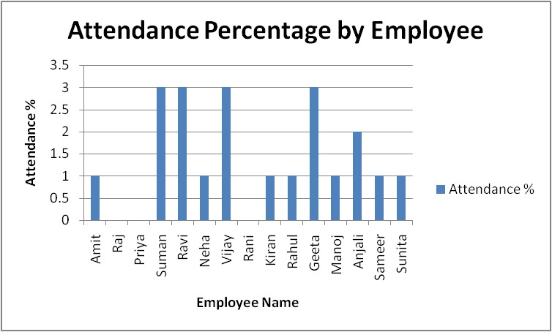
RESULTS
10

Slide 11
CONCLUSION
1.SUMMARY OF KEY FINDINGS
2. IMPACT ON OPERATIONS
3.RECOMMNDATIONS
4. ACTIONPLAN
5. FUTURE MONITORING

